Slide 1
Database Systems
Lecture 1-Chapter # 3
Data Modeling Using the Entity-Relationship (ER) Model
Alina Arshad
alina.arshad@nu.edu.pk

Slide 2
Entity–relationship (ER) model
Is a popular high-level conceptual data model.
Frequently used for the conceptual design of database applications

Slide 3
ER concepts
The ER model describes data as entities, relationships, and attributes
Entities and Their Attributes:
Entity: which is a thing or object in the real world with an independent existence.
Can be an object with a physical existence: i.e. a particular person, car, house, or employee)
Can be an object with a conceptual existence: i.e. a company, a job, or a university course)
Notes:
Entities and Their Attributes. The basic concept that the ER model represents is an entity, which is a thing or object in the real world with an independent existence. An entity may be an object with a physical existence (for example, a particular person, car, house, or employee) or it may be an object with a conceptual existence (for instance, a company, a job, or a university course). Each entity has attributes—the particular properties that describe it. For example, an EMPLOYEE entity may be described by the employee’s name, age, address, salary, and job.

Slide 4
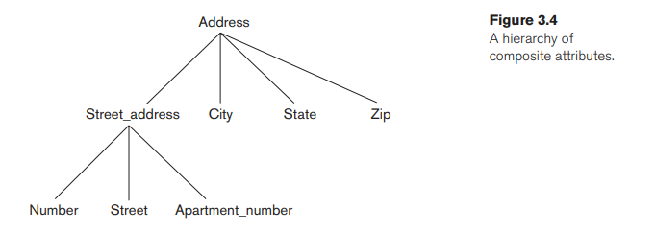
Attribute Types
Attributes: Characteristics or Properties of Entity
i.e. Employee’s First name, Last name, address etc.
Simple Attributes: are atomic
Composite attributes: divided into smaller subparts
form a hierarchy
i.e. the Address attribute of the EMPLOYEE(Street_address, City, State, and Zip)
First name and last name of employee.

Slide 5
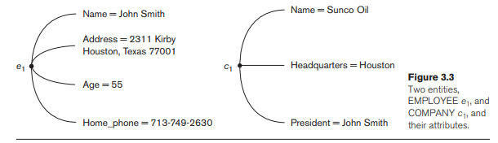
Attribute Types
Composite versus Simple (Atomic) Attributes. Composite attributes can be divided into smaller subparts, which represent more basic attributes with independent meanings.
For example, the Address attribute of the EMPLOYEE entity shown in Figure 3.3 can be subdivided into Street_address, City, State, and Zip, 3 with the values ‘2311 Kirby’, ‘Houston’, ‘Texas’, and ‘77001’.

Slide 6
Attribute Types
Single-Valued Attributes: have a single value for a particular entity.
i.e. Age is a single-valued attribute of a person.
Multivalued Attributes: have a set of values for the same entity.
i.e. Car can have more than two colors
i.e. Person can have one or more degrees in college
Have lower and upper bounds to constrain the number of values allowed for each individual entity. i.e. car can have two colors at most.
Notes:
The value of a composite attribute is the concatenation of the values of its component simple attributes. Composite attributes are useful to model situations in which a user sometimes refers to the composite attribute as a unit but at other times refers specifically to its components. If the composite attribute is referenced only as a whole, there is no need to subdivide it into component attributes. For example, if there is no need to refer to the individual components of an address (Zip Code, street, and so on), then the whole address can be designated as a simple attribute.
Single-Valued versus Multivalued Attributes. Most attributes have a single value for a particular entity; such attributes are called single-valued. For example, Age is a single-valued attribute of a person. In some cases an attribute can have a set of values for the same entity—for instance, a Colors attribute for a car, or a College_degrees attribute for a person.
Cars with one color have a single value, whereas two-tone cars have two color values. Similarly, one person may not have any college degrees, another person may have one, and a third person may have two or more degrees; therefore, different people can have different numbers of values for the College_degrees attribute. Such attributes are called multivalued. A multivalued attribute may have lower and upper bounds to constrain the number of values allowed for each individual entity. For example, the Colors attribute of a car may be restricted to have between one and two values, if we assume that a car can have two colors at most.

Slide 7

Attribute Types
Derived Attributes: two (or more) attribute values are related.
i.e. Age can be derived from birthdate
So, age is a derived attribute.
Stored Attribute: that are already specified but not derived
Complex Attributes:
i.e. a person can have more than one residence, and each residence can have a single address and multiple phones
Notes:
Stored versus Derived Attributes. In some cases, two (or more) attribute values are related—for example, the Age and Birth_date attributes of a person. For a particular person entity, the value of Age can be determined from the current (today’s) date and the value of that person’s Birth_date. The Age attribute is hence called a derived attribute and is said to be derivable from the Birth_date attribute, which is called a stored attribute. Some attribute values can be derived from related entities; for example, an attribute Number_of_employees of a DEPARTMENT entity can be derived by counting the number of employees related to (working for) that department.
Complex Attributes. Notice that, in general, composite and multivalued attributes can be nested arbitrarily. We can represent arbitrary nesting by grouping components of a composite attribute between parentheses ( ) and separating the components with commas, and by displaying multivalued attributes between braces { }. Such attributes are called complex attributes. For example, if a person can have more than one residence and each residence can have a single address and multiple phones, an attribute Address_phone for a person can be specified as shown in Figure 3.5.4 Both Phone and Address are themselves composite attributes.

Slide 8

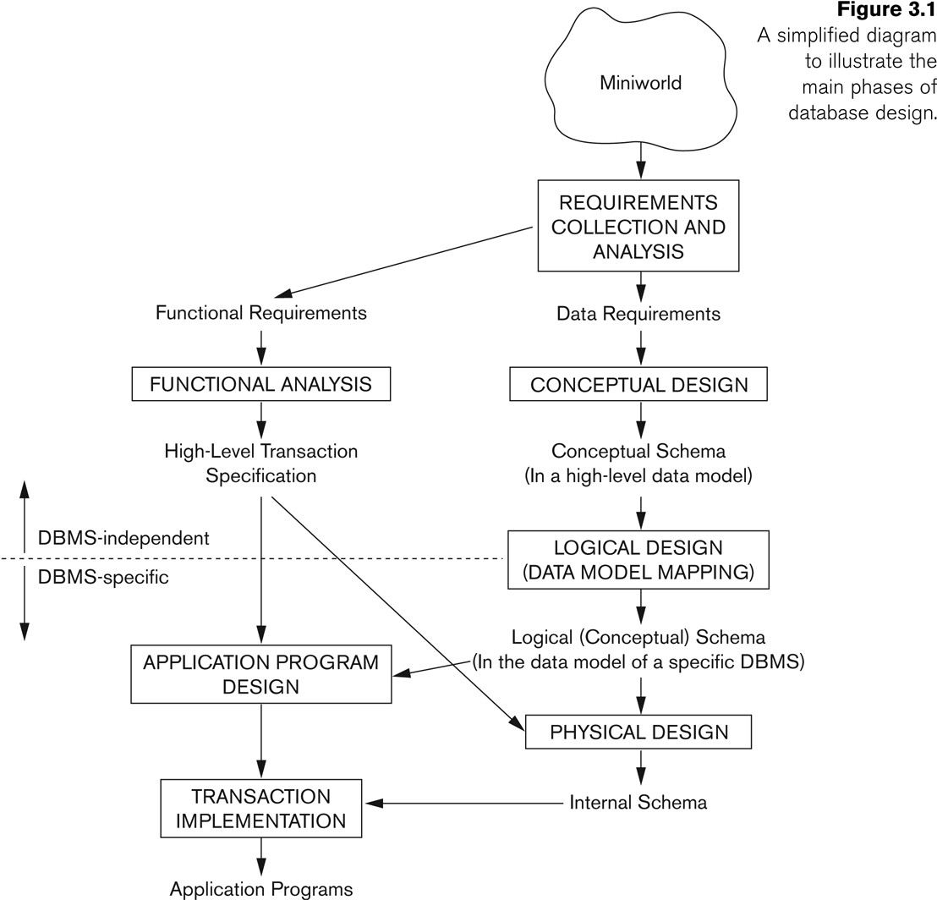
Notes:
Figure 3.1 shows a simplified overview of the database design process.
The first step shown is requirements collection and analysis. During this step, the database designers interview prospective database users to understand and document their data requirements. The result of this step is a concisely written set of users’ requirements. These requirements should be specified in as detailed and complete a form as possible. In parallel with specifying the data requirements, it is useful to specify the known functional requirements of the application. These consist of the user defined operations (or transactions) that will be applied to the database, including both retrievals and updates. In software design, it is common to use data flow diagrams, sequence diagrams, scenarios, and other techniques to specify functional requirements.
Once the requirements have been collected and analyzed, the next step is to create a conceptual schema for the database, using a high-level conceptual data model. This step is called conceptual design. The conceptual schema is a concise description of the data requirements of the users and includes detailed descriptions of the entity types, relationships, and constraints; these are expressed using the concepts provided by the high-level data model. Because these concepts do not include implementation details, they are usually easier to understand and can be used to communicate with nontechnical users. The high-level conceptual schema can also be used as a reference to ensure that all users’ data requirements are met and that the requirements do not conflict. This approach enables database designers to concentrate on specifying the properties of the data, without being concerned with storage and implementation details, which makes it is easier to create a good conceptual database design.
During or after the conceptual schema design, the basic data model operations can be used to specify the high-level user queries and operations identified during functional analysis. This also serves to confirm that the conceptual schema meets all the identified functional requirements. Modifications to the conceptual schema can be introduced if some functional requirements cannot be specified using the initial schema.
The next step in database design is the actual implementation of the database, using a commercial DBMS. Most current commercial DBMSs use an implementation data model—such as the relational (SQL) model—so the conceptual schema is transformed from the high-level data model into the implementation data model. This step is called logical design or data model mapping; its result is a database schema in the implementation data model of the DBMS.
Data model mapping is often automated or semiautomated within the database design tools.
The last step is the physical design phase, during which the internal storage structures, file organizations, indexes, access paths, and physical design parameters for the database files are specified. In parallel with these activities, application programs are designed and implemented as database transactions corresponding to the high-level transaction specifications.

Slide 9
ER concepts
Entity Types: Different Entities
Specifies Schema or intension
i.e. EMPLOYEE and COMPANY
Entity Set: The collection of all entities of a particular entity type in the database at any point in time is called an entity set or entity collection
Specifies Collection of entities: Extension
i.e. a company employing hundreds of employees
These employee entities share the same attributes, but each entity has its own value(s) for each attribute.
The tabular representation to represent data, each row in a table is a separate entity while the whole table is an entity set.
Notes:
Entity Types, Entity Sets, Keys, and Value Sets
Entity Types and Entity Sets. A database usually contains groups of entities that are similar. For example, a company employing hundreds of employees may want to store similar information concerning each of the employees. These employee entities share the same attributes, but each entity has its own value(s) for each attribute.
An entity type defines a collection (or set) of entities that have the same attributes. Each entity type in the database is described by its name and attributes. Figure 3.6 shows two entity types: EMPLOYEE and COMPANY, and a list of some of the attributes for each. A few individual entities of each type are also illustrated, along with the values of their attributes.
The collection of all entities of a particular entity type in the database at any point in time is called an entity set or entity collection;
An entity type describes the schema or intension for a set of entities that share the same structure. The collection of entities of a particular entity type is grouped into an entity set, which is also called the extension of the entity type

Slide 10
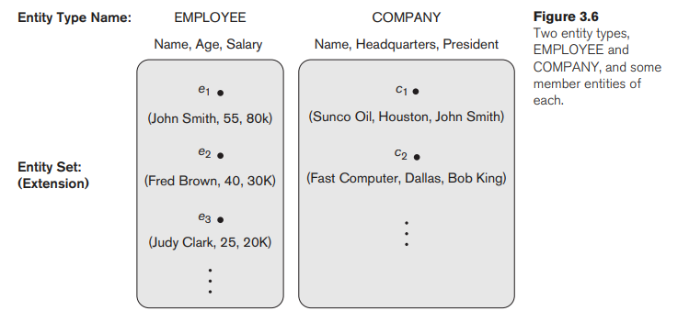
ER concepts

Slide 11
ER Concepts
Key Attributes of an Entity Type: distinct for each individual entity in the entity set. and its values can be used to identify each entity uniquely
For example, the Name attribute is a key of the COMPANY entity type because no two companies are allowed to have the same name.
A key attribute may be composite.
i.e., Registration is a key of the CAR entity type with components (Number, State).
An entity type may also have no key, in which case it is called a weak entity type.
Notes:
Key Attributes of an Entity Type. An important constraint on the entities of an entity type is the key or uniqueness constraint on attributes. An entity type usually has one or more attributes whose values are distinct for each individual entity in the entity set. Such an attribute is called a key attribute, and its values can be used to identify each entity uniquely. For example, the Name attribute is a key of the COMPANY entity type in Figure 3.6 because no two companies are allowed to have the same name. For the PERSON entity type, a typical key attribute is Ssn (Social Security number).
Sometimes several attributes together form a key, meaning that the combination of the attribute values must be distinct for each entity. If a set of attributes possesses this property, the proper way to represent this in the ER model that we describe here is to define a composite attribute and designate it as a key attribute of the entity type.
Notice that such a composite key must be minimal; that is, all component attributes must be included in the composite attribute to have the uniqueness property. Superfluous attributes must not be included in a key.
In ER diagrammatic notation, each key attribute has its name underlined inside the oval, as illustrated in Figure 3.7(a). Specifying that an attribute is a key of an entity type means that the preceding uniqueness property must hold for every entity set of the entity type. Hence, it is a constraint that prohibits any two entities from having the same value for the key attribute at the same time.
It is not the property of a particular entity set; rather, it is a constraint on any entity set of the entity type at any point in time. This key constraint (and other constraints we discuss later) is derived from the constraints of the miniworld that the database represents.
Some entity types have more than one key attribute. For example, each of the Vehicle_id and Registration attributes of the entity type CAR (Figure 3.7) is a key in its own right. The Registration attribute is an example of a composite key formed from two simple component attributes, State and Number, neither of which is a key on its own.
An entity type may also have no key, in which case it is called a weak entity type (see Section 3.5). In our diagrammatic notation, if two attributes are underlined separately, then each is a key on its own. Unlike the relational model (see Section 5.2.2), there is no concept of primary key in the ER model that we present here; the primary key will be chosen during mapping to a relational schema (see Chapter 9).

Slide 12
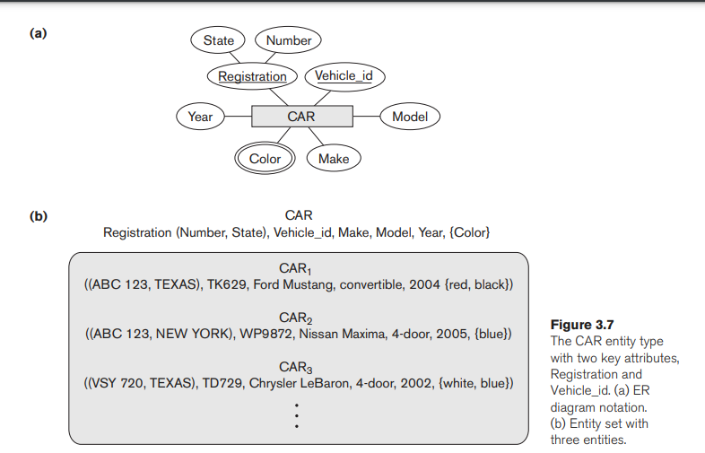

Slide 13
ER Concepts
Value Sets (Domains) of Attributes:
Values (or domain of values) represent the data from the current state
Value sets are not typically displayed in basic ER diagrams
similar to the basic data types available in most programming languages, such as integer, string, Boolean, float, subrange, and so on.
Data types of attributes can be specified in UML class diagrams (see Section 3.8) and in other diagrammatic notations used in database design tools.
Notes:
Value Sets (Domains) of Attributes. Each simple attribute of an entity type is associated with a value set (or domain of values), which specifies the set of values that may be assigned to that attribute for each individual entity. In Figure 3.6, if the range of ages allowed for employees is between 16 and 70, we can specify the value set of the Age attribute of EMPLOYEE to be the set of integer numbers between 16 and 70.
Similarly, we can specify the value set for the Name attribute to be the set of strings of alphabetic characters separated by blank characters, and so on.
Value sets are not typically displayed in basic ER diagrams and are similar to the basic data types available in most programming languages, such as integer, string, Boolean, float, enumerated type, subrange, and so on.
However, data types of attributes can be specified in UML class diagrams (see Section 3.8) and in other diagrammatic notations used in database design tools. Additional data types to represent common database types, such as date, time, and other concepts, are also employed.
The previous definition covers both single-valued and multivalued attributes, as well as NULLs. A NULL value is represented by the empty set.

Slide 14
A Sample Database Application
The COMPANY database keeps track of a company’s employees, departments, and projects.
The company is organized into departments. Each department has a unique name, a unique number, and a particular employee who manages the department. We keep track of the start date when that employee began managing the department. A department may have several locations.

Slide 15
A Sample Database Application
A department controls a number of projects, each of which has a unique name, a unique number, and a single location.
The database will store each employee’s name, a unique Social Security number, address, salary, sex (gender), and birth date.
An employee is assigned to one department, but may work on several projects, which are not necessarily controlled by the same department. It is required to keep track of the current number of hours per week that an employee works on each project, as well as the direct supervisor of each employee (who is another employee).
The database will keep track of the dependents of each employee for insurance purposes, including each dependent’s first name, sex, birth date, and relationship to the employee.

Slide 16
Initial Conceptual Design of the COMPANY Database
Four entity types:
Entity type: DEPARTMENT
Attributes: Name, Number, Locations, Manager, and Manager_start_date.
Locations is the only multivalued attribute.
key attributes: Name and Number because each was specified to be unique.
Entity type: PROJECT
Attributes: Name, Number, Location, and Controlling_department.
Key Attributes: Both Name and Number
are (separate) key attributes.
Notes:
we can identify four entity types—
An entity type DEPARTMENT with attributes Name, Number, Locations, Manager, and Manager_start_date. Locations is the only multivalued attribute. We can specify that both Name and Number are (separate) key attributes because each was specified to be unique.
An entity type PROJECT with attributes Name, Number, Location, and Controlling_department. Both Name and Number are (separate) key attributes.

Slide 17
Initial Conceptual Design of the COMPANY Database
Entity type: EMPLOYEE
Attributes: Name, Ssn, Sex, Address, Salary, Birth_date, Department, and Supervisor
Composite Attributes: Name and Address may be composite attributes; however, this was not specified in the requirements.
Notes:
An entity type EMPLOYEE with attributes Name, Ssn, Sex, Address, Salary, Birth_date, Department, and Supervisor. Both Name and Address may be composite attributes; however, this was not specified in the requirements. We must go back to the users to see if any of them will refer to the individual components of Name—First_name, Middle_initial, Last_name—or of Address. In our example, Name is modeled as a composite attribute, whereas Address is not, presumably after consultation with the users.
An entity type DEPENDENT with attributes Employee, Dependent_name, Sex, Birth_date, and Relationship (to the employee). Another requirement is that an employee can work on several projects, and the database has to store the number of hours per week an employee works on each project. This requirement is listed as part of the third requirement in Section 3.2, and it can be represented by a multivalued composite attribute of EMPLOYEE called Works_on with the simple components (Project, Hours). Alternatively, it can be represented as a multivalued composite attribute of PROJECT called Workers with the simple components (Employee, Hours). We choose the first alternative in Figure 3.8; we shall see in the next section that this will be refined into a many-to-many relationship, once we introduce the concepts of relationships.

Slide 18
Initial Conceptual Design of the COMPANY Database
Entity type: DEPENDENT
Attributes: Employee, Dependent_name, Sex, Birth_date, and Relationship (to the employee).
Multivalued composite attribute of EMPLOYEE: Works_on (Project, Hours)
or alternatively
Multivalued composite attribute of PROJECT: Workers (Employee, Hours).
We choose the first alternative in Figure 3.8;
Notes:
Another requirement is that an employee can work on several projects, and the database has to store the number of hours per week an employee works on each project. This requirement is listed as part of the third requirement in Section 3.2, and it can be represented by a multivalued composite attribute of EMPLOYEE called Works_on with the simple components (Project, Hours). Alternatively, it can be represented as a multivalued composite attribute of PROJECT called Workers with the simple components (Employee, Hours). We choose the first alternative in Figure 3.8; we shall see in the next section that this will be refined into a many-to-many relationship, once we introduce the concepts of relationships.

Slide 19
Relationship Types
Relationship Type:
Is the schema description of a relationship
Identifies the relationship name and the participating entity types
Also identifies certain relationship constraints.
For example, the attribute Manager of DEPARTMENT refers to an employee who manages the department;
the attribute Controlling_department of PROJECT refers to the department that controls the project;
the attribute Supervisor of EMPLOYEE refers to another employee (the one who supervises this employee);
the attribute Department of EMPLOYEE refers to the department for which the employee works; and so on.
Relationship Set:
The current set of relationship instances represented in the database
Notes:
In Figure 3.8 there are several implicit relationships among the various entity types. In fact, whenever an attribute of one entity type refers to another entity type, some relationship exists.
For example, the attribute Manager of DEPARTMENT refers to an employee who manages the department;
the attribute Controlling_department of PROJECT refers to the department that controls the project;
the attribute Supervisor of EMPLOYEE refers to another employee (the one who supervises this employee);
the attribute Department of EMPLOYEE refers to the department for which the employee works; and so on.
In the ER model, these references should not be represented as attributes but as relationships. The initial COMPANY database schema from Figure 3.8 will be refined in Section 3.6 to represent relationships explicitly. In the initial design of entity types, relationships are typically captured in the form of attributes. As the design is refined, these attributes get converted into relationships between entity types.

Slide 20
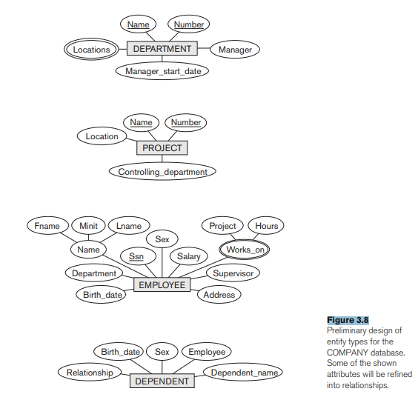

Slide 21
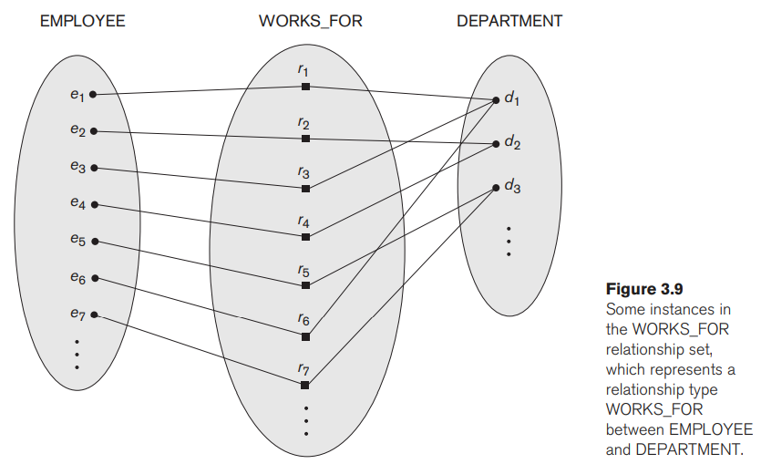

Slide 22
Relationship Types
In ER diagrams, relationship types are displayed as diamond-shaped boxes which are connected by straight lines to the rectangular boxes representing the participating entity types.
The relationship name is displayed in the diamond-shaped box

Slide 23
Relationship Degree
Degree of a Relationship Type: number of participating entity types.
i.e. WORKS_FOR relationship is of degree two (binary).
Binary degree of relationship is most common.
Recursive relationships or self-referencing relationships: same entity type participates more than once in a relationship type in different roles
Notes:
However, in some cases the same entity type participates more than once in a relationship type in different roles. In such cases the role name becomes essential for distinguishing the meaning of the role that each participating entity plays. Such relationship types are called recursive relationships or self-referencing relationships.
Figure 3.11 shows an example. The SUPERVISION relationship type relates an employee to a supervisor, where both employee and supervisor entities are members of the same EMPLOYEE entity set. Hence, the EMPLOYEE entity type participates twice in SUPERVISION: once in the role of supervisor (or boss), and once in the role of supervisee (or subordinate). Each relationship instance ri in SUPERVISION associates two different employee entities ej and ek, one of which plays the role of supervisor and the other the role of supervisee. In Figure 3.11, the lines marked ‘1’ represent the supervisor role, and those marked ‘2’ represent the supervisee role; hence, e1 supervises e2 and e3, e4 supervises e6 and e7, and e5 supervises e1 and e4. In this example, each relationship instance must be connected with two lines, one marked with ‘1’ (supervisor) and the other with ‘2’ (supervisee).
A relationship type between the same participating entity type in distinct roles
Also called a self-referencing relationship type.
Example: the SUPERVISION relationship
EMPLOYEE participates twice in two distinct roles:
supervisor (or boss) role
supervisee (or subordinate) role
Each relationship instance relates two distinct EMPLOYEE entities:
One employee in supervisor role
One employee in supervisee role

Slide 24
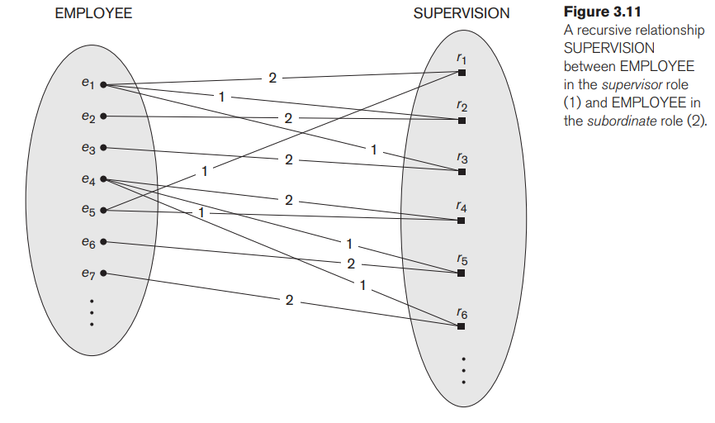
Notes:
1’ (supervisor) and the other with ‘2’ (supervisee) Employee e1 supervises Employees e2 and e3.Employee e4 supervises Employees e6 and e7.Employee e5 supervises Employees e1 and e4.s

Slide 25
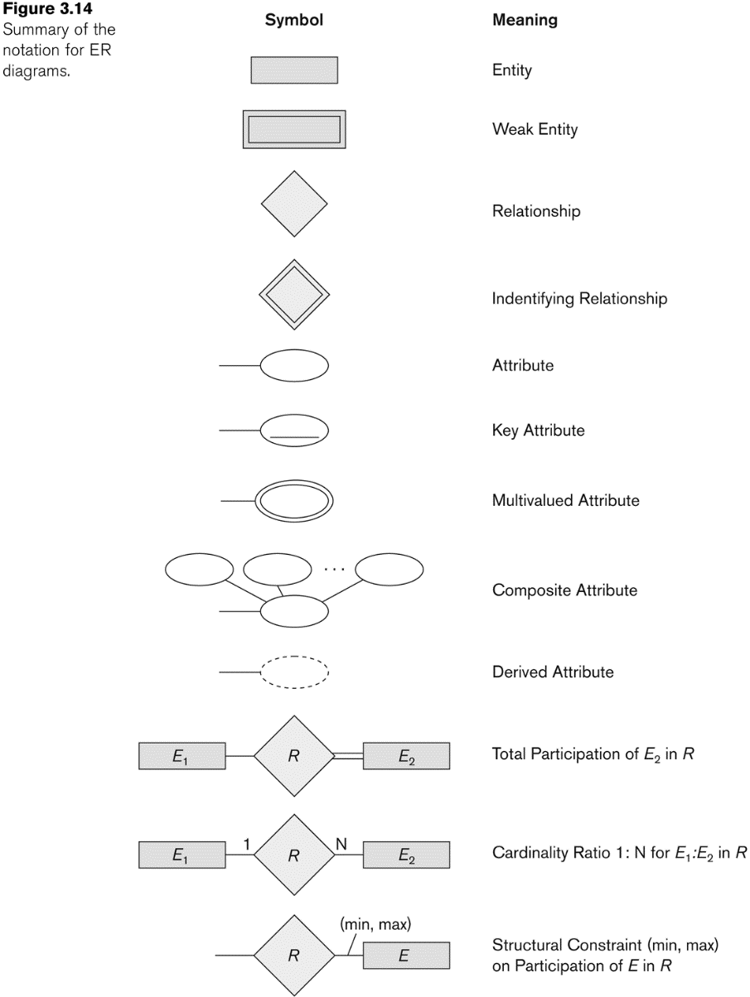
Summary of Notation for ER Diagrams
Notes:
Figure 3.2 displays the COMPANY ER database schema as an ER diagram
Regular (strong) entity types such as EMPLOYEE, DEPARTMENT, and PROJECT are shown in rectangular boxes.
Relationship types such as WORKS_FOR, MANAGES, CONTROLS, and WORKS_ON are shown in diamond-shaped boxes attached to the participating entity types with straight lines.
Attributes are shown in ovals, and each attribute is attached by a straight line to its entity type or relationship type.
Component attributes of a composite attribute are attached to the oval representing the composite attribute, as illustrated by the Name attribute of EMPLOYEE.
Multivalued attributes are shown in double ovals, as illustrated by the Locations attribute of DEPARTMENT.
Key attributes have their names underlined.
Derived attributes are shown in dotted ovals, as illustrated by the Number_of_employees attribute of DEPARTMENT.
Weak entity types are distinguished by being placed in double rectangles and by having their identifying relationship placed in double diamonds, as illustrated by the DEPENDENT entity type and the DEPENDENTS_OF identifying relationship type.
The partial key of the weak entity type is underlined with a dotted line.
In Figure 3.2 the cardinality ratio of each binary relationship type is specified by attaching a 1, M, or N on each participating edge.
The cardinality ratio of DEPARTMENT:EMPLOYEE in MANAGES is 1:1, whereas
it is 1:N for DEPARTMENT: EMPLOYEE in WORKS_FOR,
and M:N for WORKS_ON.
The participation constraint is specified by a single line for partial participation and by double lines for total participation (existence dependency).
In Figure 3.2 we show the role names for the SUPERVISION relationship type because the same EMPLOYEE entity type plays two distinct roles in that relationship. Notice that the cardinality ratio is 1:N from supervisor to supervisee because each employee in the role of supervisee has at most one direct supervisor, whereas an employee in the role of supervisor can supervise zero or more employees.

Slide 26
Practice Example
The University of Toronto has several departments. Each department is managed by a chair, and at least one professor. Professors must be assigned to one, but possibly more departments. At least one professor teaches each course, but a professor may be on sabbatical and not teach any course. Each course may be taught more than once by different professors. We know of the department name, the professor name, the professor employee id, the course names, the course schedule, the term/year that the course is taught, the departments the professor is assigned to, the department that offers the course.

